Slide 1
Relevant tax issues of Airbnb and short-term rental
Kis-Vén Valéria
Economist, registered Vat expert
Chartered accountant
Ceo of adhato könyvelő és adótanácsadó iroda
www.adhato.hu, info@adhato.hu

Slide 2
239/2009. (X. 20.) Korm. rendelet a szálláshely-szolgáltatási tevékenység folytatásának részletes feltételeiről és a szálláshely-üzemeltetési engedély kiadásának rendjéről

Slide 3
- an online travel accomodation provider - present in appr. 65.000 cities and 191 countries - in Hungary it’s name is usually used in order to express „short-term rental” (other popular providers: Booking, Trip Advisor, Flipkey, etc.) - Airbnb has grown extremely rapidly since its foundation
What is Airbnb?

Slide 4
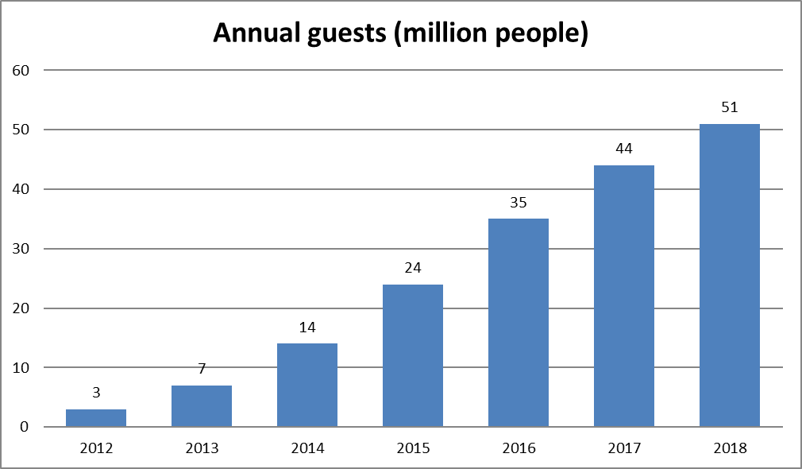
The growth of Airbnb guests in Budapest
Source: GeoJournal of Tourism and Geosites, Year XI, no. 1, vol. 21, May 2018, p.26-38

Slide 5
LONG TERM months/years compulsory tenant pays not always not needed
Differences between short-term and long-term rental
Duration: Contract: Overheads: Tax number: Cash register:
SHORT TERM
a few days or weeks
not needed
renter pays
compulsory
compulsory*

Slide 6
LONG TERM not always not needed 68.20 68.20.01-08 exempt
Differences between short-term and long-term rental
Invoice: Permission: TEÁOR: ÖVTJ: VAT:
SHORT TERM
compulsory
compulsory
55.20
55.20.06
18%

Slide 7
1. Local authority: - filling the registration form - submitting other documents (plan of the flat, statement of consent from the owner and/or from the condominium, etc) 2. Tax authority: - require tax number and EU tax number - choice of PIT, VAT, MNB exchange rate
Process of registration

Slide 8
1. Private persons with tax number: - independent activity, or - itemized flat-rate taxation 2. Private entrepreneurs and limited partnerships: - KATA-taxation (just for short-term rental!!!) - general taxation 3. Limited liability companies and others: - general taxation
Forms of taxation

Slide 9
Private Persons’ Taxation

Slide 10
1. Who can choose this type? - a private individual who provides private lodging services 2. What does „private lodging service” mean? - the activity which is undertaken in a property which is considered as an „egyéb szálláshely” according to the relevant Government Decree - the same guest uses the property for recreational or holiday purposes not more than 90 days in a tax year
Itemized flat-rate tax

Slide 11
3. What are the other conditions for selecting this type? - the activity can be undertaken in not more than three residential or resort properties and - the person should be the owner or the beneficial owner of these properties 4. What is the amount of this tax? - It is 38.400 HUF for each room in a tax year.
Itemized flat-rate tax

Slide 12
5. Is there any limit regarding incomes for choosing this type? - No. Incomes are unlimited regarding personal income tax. 6. What about the emerging costs? - They can’t be considered but in case of VAT the amount of VAT can be decucted.
Itemized flat-rate tax

Slide 13
7. When should this tax be paid? - It should be paid quarterly on the 12th day of the month following the quarter. 8. When should this tax be declared? - The individuals should declare the amount of the tax (and not the revenue!!!) in their personal income tax declaration.
Itemized flat-rate tax

Slide 14
1. When can it be used? - It depends on the person’s decision. - If the person doesn’t meet the conditions of choosing itemized flat-rate taxation. 2. How to calculate income? - We can use 10% cost ratio or cost accounting.
Independent activity

Slide 15
1. When can it be used? - It depends on the person’s decision. - If the person doesn’t meet the conditions of choosing itemized flat-rate taxation. 2. How to calculate income? - 10% cost ratio or cost accounting methods can be used.
Independent activity

Slide 16
3. How does 10% cost ratio works? - The 90% of the revenue is the tax base. - No need to collect any documents certifying incurred costs. 4. How does cost accounting method works? - The incurred and certified costs can be deducted from the revenue up to the total amount of it.
Independent activity

Slide 17
5. What kinds of taxes should be paid on the tax base? - 15% personal income tax, - 19,5 % health insurance contribution (no limit!) 6. When should be the taxes paid and declared? - Paid: quarterly in advance - Declared: in the PIT-declaration.
Independent activity

Slide 18
Value Added Tax

Slide 19
- generally 18% VAT must be charged on this service - VAT exemption can be selected up to the value limit of 8 million HUF according to general rules
VAT regarding short-term rental services

Slide 20
- Airbnb and other providers charge commission for their services - this means commercial relation between them - if a taxable person establishes commercial relations with any taxpayer established in another member state of EU, then EU tax number should be required
VAT regarding commission

Slide 21
- this community tax number should be indicated on all the invoices issued between them - so the 27% VAT on the commission charged by Airbnb should be paid by the Hungarian party even if VAT exemption on the short rental services is selected - VAT declaration (1865, 18A60): general rules (in case of VAT-exemption the frequency is monthly)
VAT regarding commission

Slide 22
Tourist tax

Slide 23
- Tourist tax belongs to the local municipality - It should be paid by the guests - Accomodation providers has only tax collection liability - payment liability has to be fullfilled even if the provider forgot to collect it
Tourist tax

Slide 24
- The tax rates are variable on each municipality taken into account the statutory maximum - Tax rates can be based on the revenue for the accomodation (4% of it) or based on the overnight stays (appr. 450-650 HUF/person/night)
Tourist tax

Slide 25
- Tourist tax should be paid to the local government’s bank account - The due date of payment and filing tax declaration is the 15th of the following month - Tax exemption applies to persons under 18 year - Basic documentation is „vendégkönyv”
Tourist tax

Slide 26
Building tax

Slide 27
- can be imposed by the local government (depending on their decision and regulation) - it is payable by the owner in advance, two times a tax year (15 March and 15 September) - tax rates and the tax base vary from each municipality (usually around 1,600 HUF/m2)
Building tax

Slide 28
Other obligations

Slide 29
- In the case of companies the general rules should be applied on registering revenues and costs - as for private persons the type of documentation depends on the applied method of taxation
Documentation

Slide 30
- In case of itemized flat-rate taxation, 10% cost ratio and KATA taxation revenue recording is enough - in case of cost accounting revenue and expense record is the basic type - but in case of VAT obligation cash journal or general ledger should be used
Documentation

Slide 31
- If the accommodation provider doesn’t want to use cash register in case of cash payment, he is obliged to issue invoice for the guest - the data of these invoices should be declared to NAV till 15th of the following month (on PTGSZLAH form)
Cash registers

Slide 32
Basic problems

Slide 33
- Airbnb issues invoices only for the registered persons (but the commission is paid by the persons who are registered under his name) - Booking doesn’t care with VAT (the invoice never contain VAT even if there is no EU tax number is indicated)
Basic problems

Slide 34
- Tax authority is not prepared enough to provide reliable pieces of information for the accommodation providers (administrators don’t have thorough knowledge and usually provide false advices) => several times it is revealed that the person was not entitled to select itemized flat-rate taxation and so much tax has to be paid later.
Basic problems

Slide 35
- Personal income tax declaration doesn’t ensure opportunity for persons applying itemized flat-rate tax to indicate their revenues (only the number of taxable rooms should be indicated) => if they want to take a loan, there is no official certification from NAV for them
Basic problems

Slide 36
☺ Thank you for your attention! ☺

